Slide 1

Graphical Password using Image Segmentation
This presentation explores how graphical passwords leverage image segmentation for enhanced security. We'll examine its principles, advantages, and implementation.
Prepared By:
Sourabh Sinha [23SCSE2150018]
Saurabh Kumar [23SCSE2030726]
Tanish Tyagi [23SCSE2150023]

Slide 2
What is a graphical password?
Traditional Passwords
Graphical Passwords
Traditional passwords rely on text-based sequences, prone to brute-force attacks and susceptibility to forgetting.
Graphical passwords use visuals for authentication, increasing memorability and security by relying on visual pattern recognition.

Slide 3

How does image segmentation work?
Image Analysis
Pixel Grouping
Grid Creation
The image is analyzed to identify distinct regions based on colors, textures, and other visual characteristics.
Similar pixels are grouped together to form segments representing different objects or areas within the image.
The segmented image is divided into a grid, typically a 4x4 matrix, creating a visual puzzle for authentication.

Slide 4

Benefits of a graphical password
1
Enhanced Memorability
2
Increased Security
Graphical passwords are harder to guess or brute-force, providing stronger protection against unauthorized access.
Visuals are easier to remember than text sequences, making it more user-friendly.
3
User-Friendly Interface
Graphical passwords are intuitive and engaging, making authentication more enjoyable for users.

Slide 5


Step 1: User uploads an image
Image Selection
Users choose an image they find memorable and meaningful, such as a personal photo or a favorite artwork.

Slide 6

Step 2: Image is segmented into a 4x4 grid
1
Segmentation Process
The image is automatically segmented into 16 individual squares, preserving the original visual elements.
2
Grid Display
The 16 squares are then arranged randomly within a 4x4 grid, creating a unique visual puzzle.

Slide 7



Step 3: User authenticates by rearranging the segments
Puzzle Interaction
Users interact with the grid, dragging and dropping the segments to rearrange them in their original order.
Authentication
Once the segments are correctly rearranged, the system verifies the user's identity, granting access.

Slide 8

Securing documents with graphical passwords
1
2
Data Encryption
Graphical Key
The document is encrypted using a secure algorithm, making it unreadable without proper authorization.
The graphical password serves as the decryption key, enabling only authorized users to unlock the document.

Slide 9
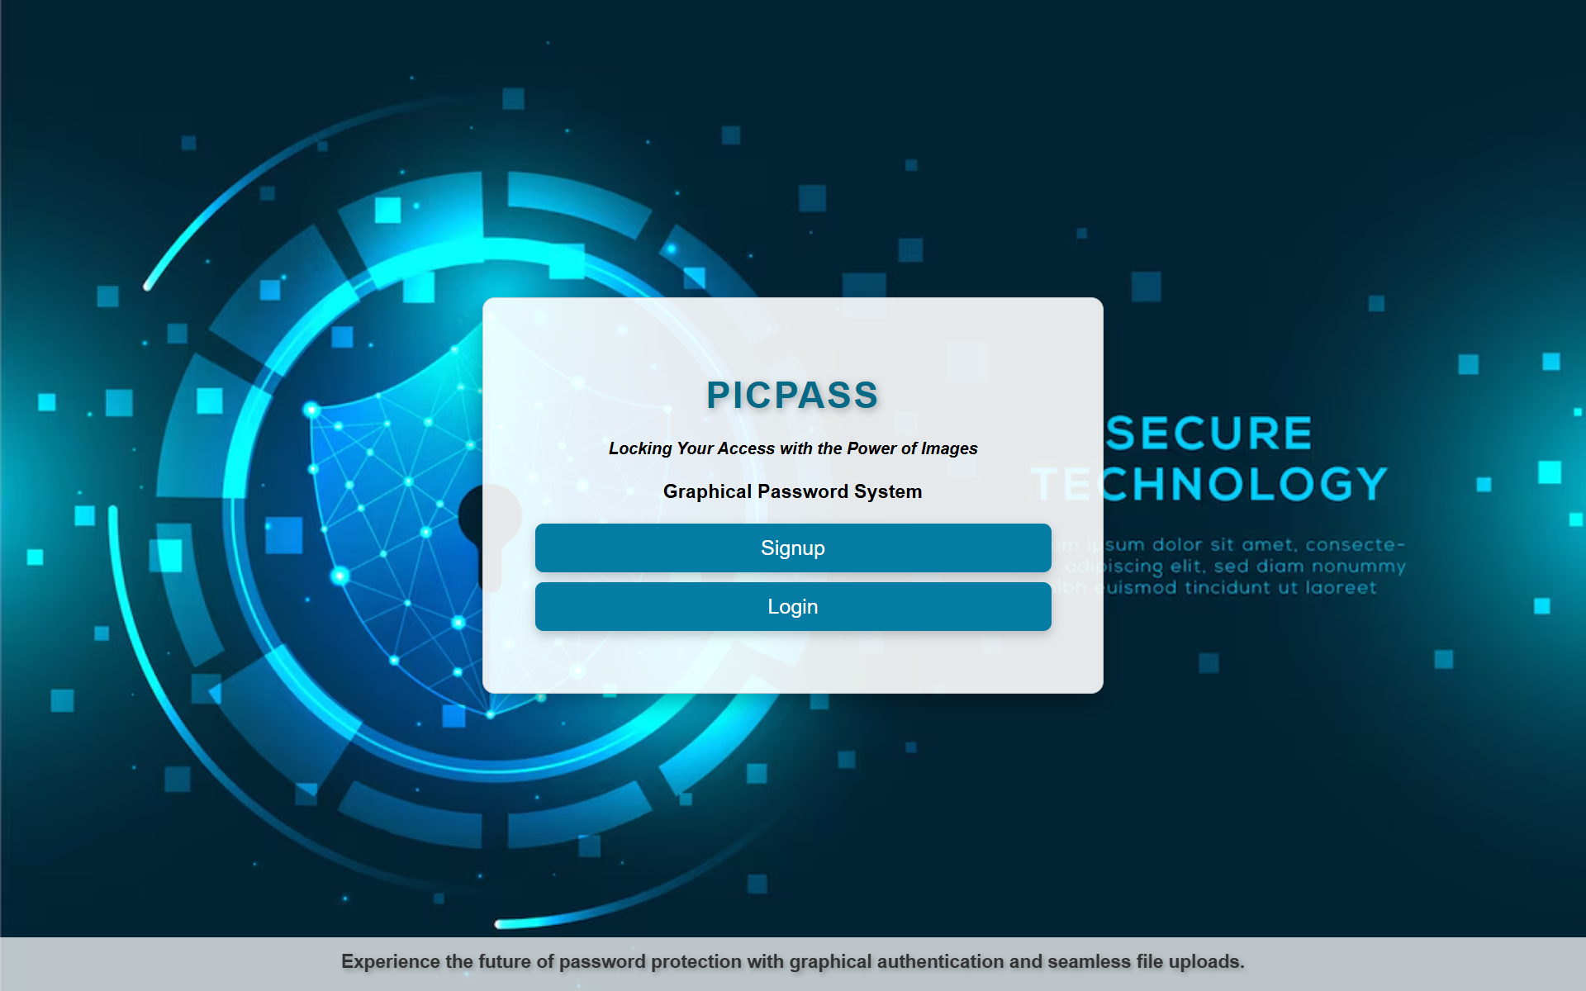
SCREENSHOTS

Slide 10


Slide 11
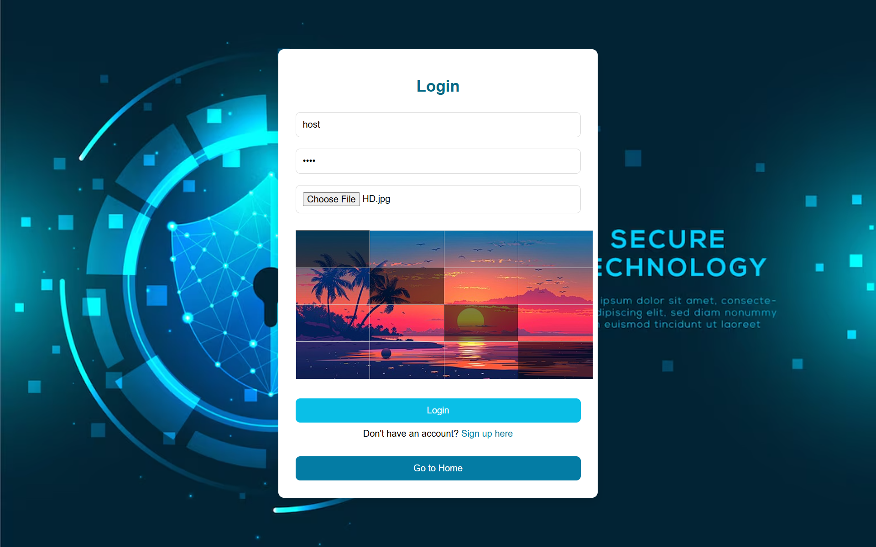

Slide 12
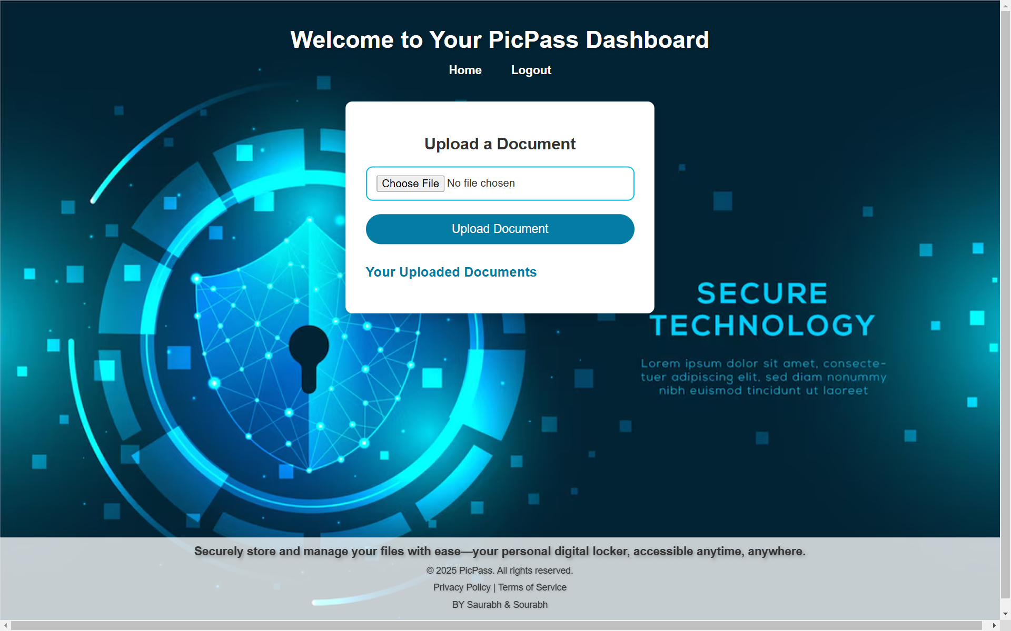

Slide 13
